Slide 1
How to Spot/Detect Money Laundering
Presented By: CDS Ahmad Ghali
Thursday, 25th March 2021

Slide 2
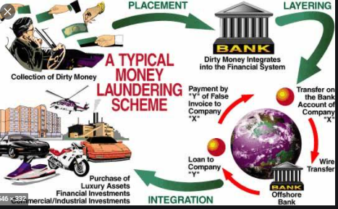
Money Laundering
Money laundering is an illegal process of making money obtained from illegal activities appear to be legal.
The illegal sources includes aspects like drug trafficking, terrorism, fraud and corruption.
The process involves moving the money through banks and other business.
The process is done so that it may seem like the money is being earned legally.

Slide 3
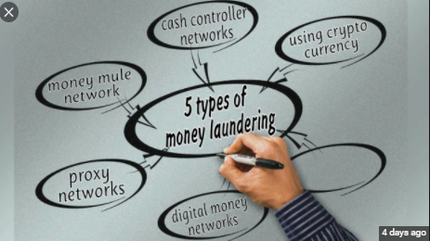
Types of Money Laundering
Structuring
Bulk Smuggling
Investment in commodities like diamond, gold and other precious gems.
Trade-based laundering
Use of shell companies and trusts
Casinos
Online gambling

Slide 4
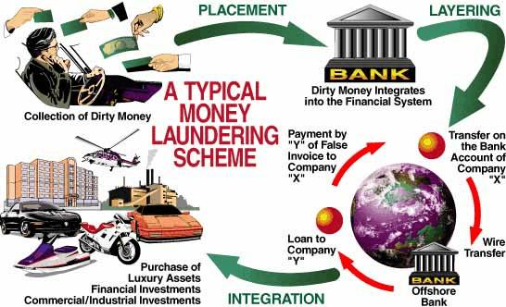
STAGES OF MONEY LAUNDERING
Money Laundering involves three basic stages viz Placement, Layering and Integration. A money laundering scheme is complete when this three stages are satisfied.
During the Placement stage, “dirty money”(proceeds of unlawful activities) is introduced into a legitimate financial system or a Designated Non Financial Institution usually through series of structured payments below reporting thresholds of Jurisdictions.
The Layering stage which is the most complex stage of Money Laundering involves perfoming series of complex transactions to third parties, shell companies, sham loans etc to conceal the true origin of the ill gotten funds.
In the Integration stage, the now laundered money is withdrawn from the legitimate source to investments, real estates and other ventures.

Slide 5
Legal Implications of Money laundering in the UK
In the UK, money laundering cases are investigated either by the National Crime Agency or Her Majesty’s Revenue and Customs.
The highest maximum for persons convicted of money laundering offences is 14 years in prison or an unlimited fine. ("Anti-Money Laundering 2020 | UK | Laws And Regulations | ICLG")
The above penalty is applicable to both natural persons and corporations.

Slide 6
Legal Implications of Money Laundering in the US
USA was the first country to criminalize money laundering activities.
The U.S Department of Justice is the agency responsible for investigating and prosecuting money laundering activities.
Imprisonment for money laundering activities is applicable for up to 20 years ("Anti-Money Laundering 2020 | Laws And Regulations | USA | ICLG").
Moreover, the maximum penalties or fines is up to $500,000 or double the amount for each violation.

Slide 7
Legal Implications of Money Laundering in Nigeria
The provision of money laundering in Nigeria are enforced by Money Laundering Prohibition Act through the Economic and the Financial Crimes Commission (Ogundipe).
The above act is applicable to both natural and legal persons.
Furthermore, in Nigeria there are no common law defenses to persons charged with money laundering offences.
The penalty for money laundering includes an imprisonment for between two or three years (Ogundipe).
Moreover, an individual may be fined a penalty of at least 1 million Naira and25 million for corporate bodies involved in the activity.

Slide 8
MEASURES TO DETECT AND COMBAT MONEY LAUNDERING
The most effective way to detect money laundering is to adopt measures to identify and break the cycle of money laundering.(Placement, Layering and Integration).
PLACEMENT STAGE:
According to the Association of Certified Fraud Examiners, the Placement stage represent the most dangerous stage for the criminal because the placement process creates a direct connection between profits and the crime. Most detection occur at this stage because of strong financial and regulatory requirements such as the Special Control Unit against Money Laundering(SCUML), filing of Suspicious Transaction Report(STR’s) and Currency Transaction Reports(CTR’s).
The key to detecting and combating Money Laundering at this stage is to strengthen financial disclosure requirement by Designated and Non Designated Financial Institutions (DFI’s and DNFI’s) and maintenance of an effective whistleblowing policy with non retaliation privileges.

Slide 9
MEASURES TO DETECT AND COMBAT MONEY LAUNDERING CONT’D
LAYERING:
Layering undoubtedly represents the most difficult and complex stage of the m0ney laundering process as the criminal keeps investigators confused as to the genuine source of their funds through series of complex transactions designed to eliminate audit and paper trail.
One key method of detecting and combating Money Laundering at this stage is encouraging Whistle-blower protection and offering financial reward to people who can offer useful and genuine information on suspicious money laundering activities (positive reinforcement).
No one person can effectively carryout a money laundering scheme. Usually, criminals use professionals such as Accountants, Lawyers, Bankers etc to carryout complex transactions at this stage. The most effective method of combating the Layering stage of Money laundering involving the use of professionals is by ensuring that they abide by the established ethical codes of their professions and ensuring that deviants are prosecuted(punishment).
In the same vein, the Ethical codes of conduct of these professionals should be continuously updated to reflect current trends in Anti-Money Laundering.

Slide 10
MEASURES TO DETECT AND COMBAT MONEY LAUNDERING CONT’D
INTEGRATION:
The integration stage involves incorporating the proceeds of crime back to the economy in a manner that legitimises the wealth created.
The key to detecting Money Laundering at this stage is mainly living above ones means(unexplained wealth).
To combat Money laundering at this stage, investigators and fraud Examiners should carryout lifestyle audit to determine if suspected cases of Living above means could be explained by legitimate source of income( see Section 7(b) of the EFCC Act, 2004 as amended).

Slide 11
Conclusion
Money laundering not only threatens the regional economy but also the global one as most fraud cut across Jurisdictions.
Failure to counter it will lead to progression of more crimes within the society. Money laundering is always a predicative Offence.
The key to fighting Money Laundering is in identifying and breaking the cycle of placement, Layering and Integration.
Compliance with the recommendations of the Financial Action Taskforce (FATF) ensures effective prevention of Money laundering as it is easier to prevent fraud than to detect fraud.

Slide 12
References
"Anti-Money Laundering 2020 | Laws And Regulations | USA | ICLG". International Comparative Legal Guides International Business Reports, 2021, https://iclg.com/practice-areas/anti-money-laundering-laws-and-regulations/usa.
"Anti-Money Laundering 2020 | UK | Laws And Regulations | ICLG". International Comparative Legal Guides International Business Reports, 2021, https://iclg.com/practice-areas/anti-money-laundering-laws-and-regulations/united-kingdom.
Ogundipe, Sofunde. "In Brief: Money Laundering Offences In Nigeria | Lexology". Lexology.Com, 2020, https://www.lexology.com/library/detail.aspx?g=703ae3f4-e0d8-4894-8930-aecc5c0f50ae.

Slide 13
REFERENCES CONT’D
ACFE Fraud Examiners Manual “Financial Transactions and Fraud Scheme-Money laundering 2021 Edition.
FATF (2012-2020)“International Standards on Combating Money Laundering and the Financing of Terrorism & Proliferations, FATF, Paris France.
Economic and Financial Crimes Commission(Establishment) Act, 2004 ‘’Special Powers of the Commission pg.7

